Slide 1
PODCAST PLUS-ANDROID
Team Members:
THARSAN S-711222104056
SUHAAS V-71122210052
SOMESWARAN T-711222104047
MOHAMMED FAZIL M-711222104302

Slide 2
DESCRIPTION
Podcast App - Dynamic Themes & Redux-Powered Experience
An intuitive podcast app built with Redux for seamless state management and dynamic themes for a fully customizable listening experience.
Smooth Navigation: Powered by Redux, ensuring consistent and efficient state management across the app.
Dynamic Themes: Easily switch between light, dark, and custom themes to match your style or time of day.
Podcast Discovery: Browse, search, and listen to a vast collection of podcasts tailored to your interests.
Offline Listening: Download episodes and listen on-the-go without an internet connection.
Personalized Recommendations: Get episode suggestions based on your listening habits.
Enjoy an optimized, personalized, and visually dynamic podcast experience on Android!

Slide 3
Main Activity.java:
package com.example.podcastplayer;
public final class BuildConfig {
public static final boolean DEBUG = Boolean.parseBoolean("true");
public static final String APPLICATION_ID = "com.example.podcastplayer";
public static final String BUILD_TYPE = "debug";
public static final int VERSION_CODE = 1;
public static final String VERSION_NAME = "1.0";
}

Slide 4
<?xml version="1.0" encoding="utf-8"?>
<vector xmlns:android="http://schemas.android.com/apk/res/android"
android:width="108dp"
android:height="108dp"
android:viewportWidth="108"
android:viewportHeight="108">
<path
android:fillColor="#3DDC84"
android:pathData="M0,0h108v108h-108z" />
<path
android:fillColor="#00000000"
android:pathData="M9,0L9,108"
android:strokeWidth="0.8"
android:strokeColor="#33FFFFFF" />
<path
android:fillColor="#00000000"
android:pathData="M19,0L19,108"
android:strokeWidth="0.8"
android:strokeColor="#33FFFFFF" />

Slide 5
AndroidManifest.xml
<?xml version="1.0" encoding="utf-8"?><!--
Sample data extraction rules file; uncomment and customize as necessary.
See https://developer.android.com/about/versions/12/backup-restore#xml-changes
for details.
-->
<data-extraction-rules>
<cloud-backup>
<!-- TODO: Use <include> and <exclude> to control what is backed up.
<include .../>
<exclude .../>
-->
</cloud-backup>
<!--
<device-transfer>
<include .../>
<exclude .../>
</device-transfer>
-->
</data-extraction-rules>

Slide 6
<?xml version="1.0" encoding="utf-8"?>
<vector xmlns:android="http://schemas.android.com/apk/res/android"
android:width="108dp"
android:height="108dp"
android:viewportWidth="108"
android:viewportHeight="108">
<path
android:fillColor="#3DDC84"
android:pathData="M0,0h108v108h-108z" />
<path
android:fillColor="#00000000"
android:pathData="M9,0L9,108"
android:strokeWidth="0.8"
android:strokeColor="#33FFFFFF" />
<path
android:fillColor="#00000000"
android:pathData="M19,0L19,108"
android:strokeWidth="0.8"
android:strokeColor="#33FFFFFF" />

Slide 7
<path
android:fillColor="#00000000"
android:pathData="M29,0L29,108"
android:strokeWidth="0.8"
android:strokeColor="#33FFFFFF" />
<path
android:fillColor="#00000000"
android:pathData="M39,0L39,108"
android:strokeWidth="0.8"
android:strokeColor="#33FFFFFF" />
<path
android:fillColor="#00000000"
android:pathData="M49,0L49,108"
android:strokeWidth="0.8"
android:strokeColor="#33FFFFFF" />

Slide 8
<path
android:fillColor="#00000000"
android:pathData="M59,0L59,108"
android:strokeWidth="0.8"
android:strokeColor="#33FFFFFF" />
<path
android:fillColor="#00000000"
android:pathData="M69,0L69,108"
android:strokeWidth="0.8"
android:strokeColor="#33FFFFFF" />
<path
android:fillColor="#00000000"
android:pathData="M79,0L79,108"
android:strokeWidth="0.8"
android:strokeColor="#33FFFFFF" />

Slide 9
<path
android:fillColor="#00000000"
android:pathData="M59,19L59,89"
android:strokeWidth="0.8"
android:strokeColor="#33FFFFFF" />
<path
android:fillColor="#00000000"
android:pathData="M69,19L69,89"
android:strokeWidth="0.8"
android:strokeColor="#33FFFFFF" />
<path
android:fillColor="#00000000"
android:pathData="M79,19L79,89"
android:strokeWidth="0.8"
android:strokeColor="#33FFFFFF" />
</vector>

Slide 10
<vector xmlns:android="http://schemas.android.com/apk/res/android"
xmlns:aapt="http://schemas.android.com/aapt"
android:width="108dp"
android:height="108dp"
android:viewportWidth="108"
android:viewportHeight="108">
<path android:pathData="M31,63.928c0,0 6.4,-11 12.1,-13.1c7.2,-2.6 26,-1.4 26,-1.4l38.1,38.1L107,108.928l-32,-1L31,63.928z">
<aapt:attr name="android:fillColor">
<gradient
android:endX="85.84757"
android:endY="92.4963"
android:startX="42.9492"
android:startY="49.59793"
android:type="linear">

Slide 11
<item
android:color="#44000000"
android:offset="0.0" />
<item
android:color="#00000000"
android:offset="1.0" />
</gradient>
</aapt:attr>
</path>
<path
android:fillColor="#FFFFFF"
android:fillType="nonZero"
android:pathData="M65.3,45.828l3.8,-6.6c0.2,-0.4 0.1,-0.9 -0.3,-1.1c-0.4,-0.2 -0.9,-0.1 -1.1,0.3l-3.9,6.7c-6.3,-2.8 -13.4,-2.8 -19.7,0l-3.9,-6.7c-0.2,-0.4 -0.7,-0.5 -1.1,-0.3C38.8,38.328 38.7,38.828 0.4c0.7,0.3 1.2,1 1.2,1.8C45.3,56.528 44.5,57.328 43.4,57.328L43.4,57.328zM64.6,57.328c-0.8,0 -1.5,-0.5 -1.8,-1.2s-0.1,-1.5 0.4,-2.1c0.5,-0.5 1.4,-0.7 2.1,-0.4c0.7,0.3 1.2,1 1.2,1.8C66.5,56.528 65.6,57.328 64.6,57.328L64.6,57.328z"
android:strokeWidth="1"
android:strokeColor="#00000000" />
</vector>

Slide 12
app:layout_constraintTop_toTopOf="@id/course_name"
app:layout_constraintBottom_toBottomOf="@id/course_steps"
app:layout_constraintStart_toStartOf="@id/course_name"
app:elevationOverlay="@{@dimen/card_elevation}"/>
<Space
android:id="@+id/space"
android:layout_width="0dp"
android:layout_height="0dp"
app:layout_constraintStart_toStartOf="parent"
app:layout_constraintTop_toTopOf="parent"
app:layout_constraintEnd_toStartOf="@id/course_image"/>
<ImageView
android:id="@+id/course_image"
android:layout_width="0dp"
android:layout_height="0dp"
app:layout_constraintStart_toEndOf="@id/space"
app:layout_constraintEnd_toStartOf="@id/course_name"
app:layout_constraintTop_toTopOf="@id/course_name"
app:layout_constraintBottom_toBottomOf="@id/course_steps"
app:layout_constraintDimensionRatio="1:1"
app:srcCompat="@drawable/stroked_course_image_placeholder"

Slide 13
<path
android:fillColor="#00000000"
android:pathData="M29,0L29,108"
android:strokeWidth="0.8"
android:strokeColor="#33FFFFFF" />
<path
android:fillColor="#00000000"
android:pathData="M39,0L39,108"
android:strokeWidth="0.8"
android:strokeColor="#33FFFFFF" />
<path
android:fillColor="#00000000"
android:pathData="M49,0L49,108"
android:strokeWidth="0.8"
android:strokeColor="#33FFFFFF" />
<path
android:fillColor="#00000000"
android:pathData="M59,0L59,108"
android:strokeWidth="0.8"
android:strokeColor="#33FFFFFF" />

Slide 14
app:layout_constraintStart_toStartOf="@id/course_name"
app:layout_constraintTop_toTopOf="@id/course_steps"
app:layout_constraintBottom_toBottomOf="@id/course_steps"
android:paddingStart="@dimen/grid_2"
app:srcCompat="@drawable/ic_course"
app:tint="?attr/colorPrimary"
android:importantForAccessibility="no"/>
<TextView
android:id="@+id/course_steps"
android:layout_width="0dp"
android:layout_height="wrap_content"
app:layout_constraintStart_toEndOf="@id/course_icon"
app:layout_constraintEnd_toStartOf="@id/course_instructor"
app:layout_constraintTop_toBottomOf="@id/course_name"
app:layout_constraintBottom_toBottomOf="parent"
android:paddingStart="@dimen/grid_1"
android:paddingVertical="@dimen/grid_2"
android:textColor="?attr/colorPrimary"
android:textAppearance="?attr/textAppearanceCaption"
android:text="@{@string/course_steps(course.step, course.steps)}"
tools:text="@sample/courses.json/data/step"/>

Slide 15
package com.example.podcastplayer
import android.content.Context
import androidx.room.Database
import androidx.room.Room
import androidx.room.RoomDatabase
@Database(entities = [User::class], version = 1)
abstract class UserDatabase : RoomDatabase() {
abstract fun userDao(): UserDao
companion object {
@Volatile
private var instance: UserDatabase? = null
fun getDatabase(context: Context): UserDatabase {
return instance ?: synchronized(this) {

Slide 16
val newInstance = Room.databaseBuilder(
context.applicationContext,
UserDatabase::class.java,
"user_database"
).build()
instance = newInstance
newInstance
}
}
}
<androidx.coordinatorlayout.widget.CoordinatorLayout
android:layout_width="match_parent"
android:layout_height="match_parent"
android:background="?attr/colorPrimarySurface"

Slide 17
@Delete
suspend fun deleteUser(user: User)
} app:liftOnScroll="true"
app:liftOnScrollTargetViewId="@id/search_results"
android:theme="@style/ThemeOverlay.Owl.Blue.Dark">
<androidx.appcompat.widget.Toolbar
android:layout_width="match_parent"
android:layout_height="wrap_content"
app:layout_scrollFlags="scroll|enterAlways|snap"
android:minHeight="?attr/actionBarSize"
app:navigationIcon="@drawable/ic_search"
app:contentInsetStartWithNavigation="0dp"
app:menu="@menu/account">

Slide 18
<EditText
android:layout_width="match_parent"
android:layout_height="wrap_content"
android:background="@null"
android:lines="1"
android:selectAllOnFocus="true"
android:inputType="textCapWords"
android:imeOptions="actionSearch"
android:hint="@string/search_owl"
android:textAppearance="?attr/textAppearanceSubtitle1"/>
</androidx.appcompat.widget.Toolbar>
</com.google.android.material.appbar.AppBarLayout>
<androidx.recyclerview.widget.RecyclerView
android:id="@+id/search_results"
android:layout_width="match_parent"
android:layout_height="match_parent"

Slide 19
app:layout_behavior="com.google.android.material.appbar.AppBarLayout$ScrollingViewBehavior"
app:layoutManager="androidx.recyclerview.widget.LinearLayoutManager"
app:hasFixedSize="@{true}"
android:scrollbars="vertical"
tools:listitem="@layout/search_item"/>
</androidx.coordinatorlayout.widget.CoordinatorLayout>
</layout>

Slide 20
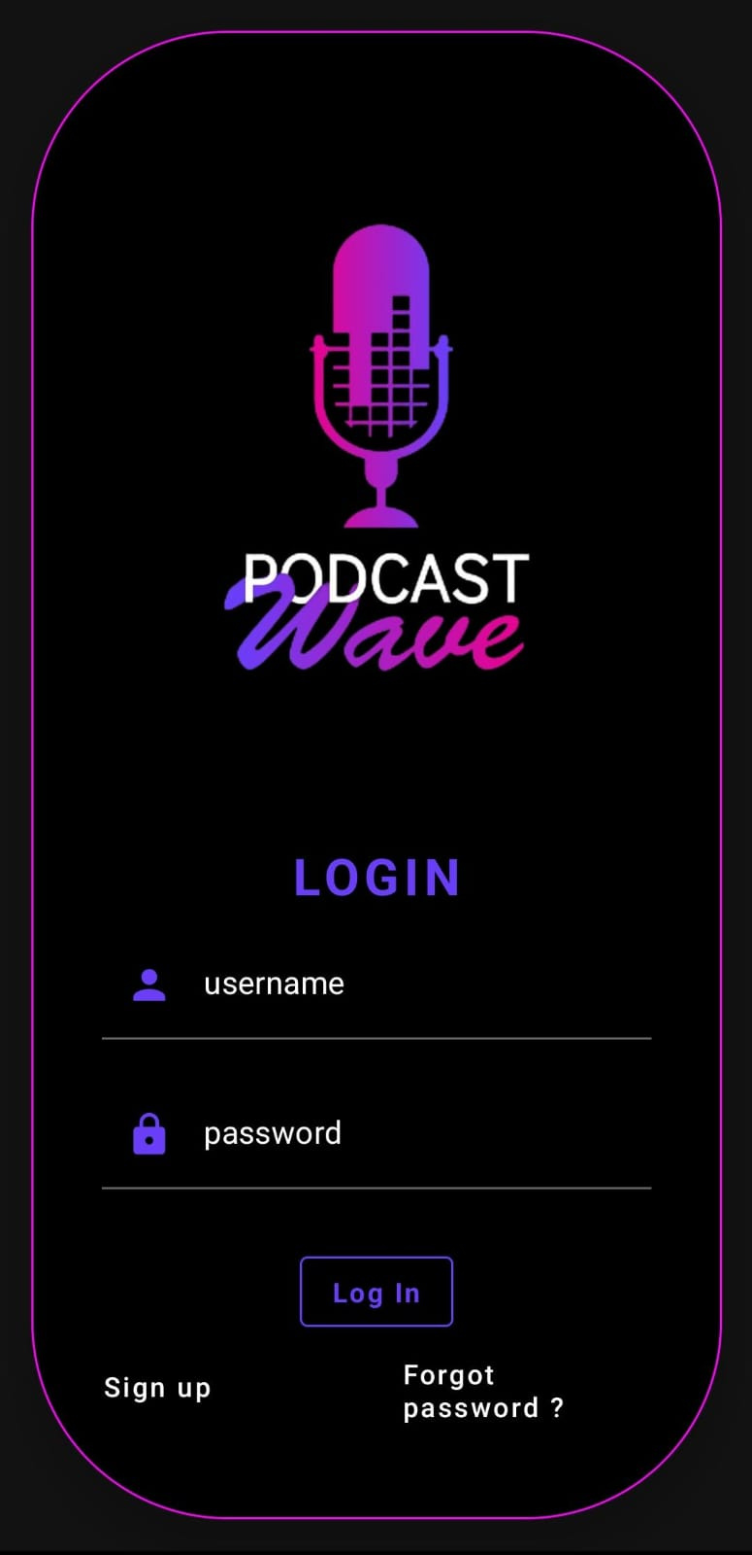
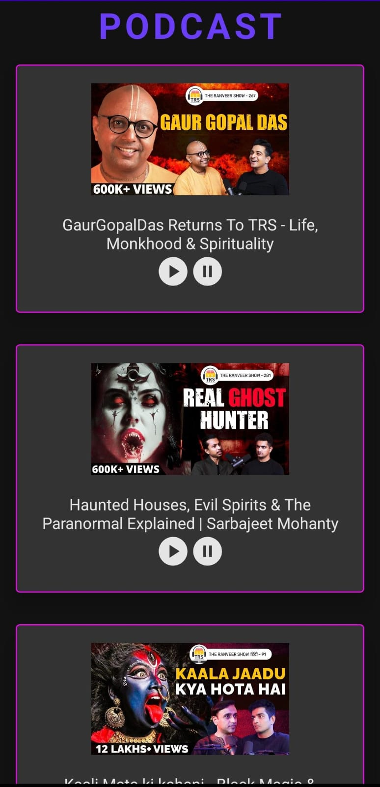
OUTPUT:

Slide 21
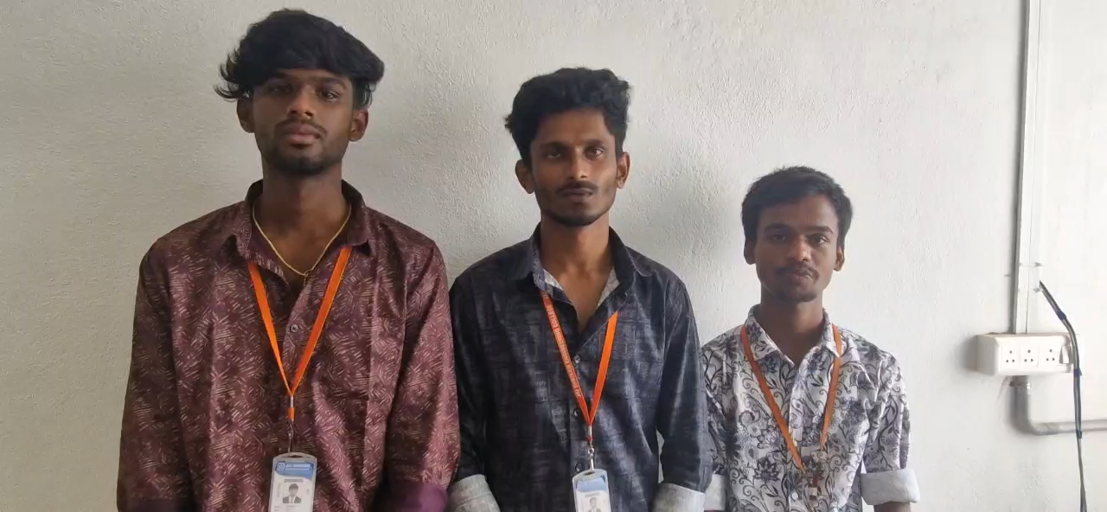
Demo video:

